Slide 1
ODA – TSA/Optus Support Process Walkthrough
Date: 06/07/2012

Slide 2
Agenda
Intro and Review of Objectives
Finalise Scenario Details and Selection
Scenario Walkthrough
Review of Actions and Issues

Slide 3
Objectives
Validate the end-to-end flow of incident management across multiple solution components, platforms, teams and organisations.
Identify process or documentation gaps for resolution
Characterise the end-to-end diagnosis and resolution time based on accumulated SLA’s
Identify gaps between target SLA’s and likely timelines

Slide 4
Process
Workshop will use up to 9 failure scenarios involving a primary defect in one component of the platform. (See Scenario Master List)
The workshop team will start by identifying:
the locus of the failure within the system
The mechanism by which this failure will be detected (e.g. Alarms, operations process, business process, customer call)
By the detection mechanism identify the organisation that will first be notified or become aware of the failure.
From that point, the workshop team will walk through the incident notification, handoff and escalation process, and the high level actions performed by each group, until the problem is resolved.
At each point, capture the defined maximum and most likely timeframes for the action or handoff to occur
Optionally, and time permitting, each team should capture the information, tools or support that will be required in order to perform the required action.

Slide 5
Notes:
It’s possible that we won’t have the attendees or the information available to answer some of the questions. In this case:
an action will be taken for the question to be answered and any gap resolved (either by Optus group or TSA)
The workshop will pick up at the next known point and continue
Tasks that are performed at each point by Optus or TSA team will be mentioned at the highest level. This workshop is not looking at how this is conducted, just what is being done and what the next handoff will be
Each Team will be expected to capture their own actions. Only gaps will be captured by the workshop. Accountability for resolving the gaps will rest with the owning organisation.

Slide 6
Roles
IT Action Taker: _________________
TSA Action Taker: ___________________

Slide 7
Supporting Diagrams
Overleaf are system schematics that may be useful

Slide 8
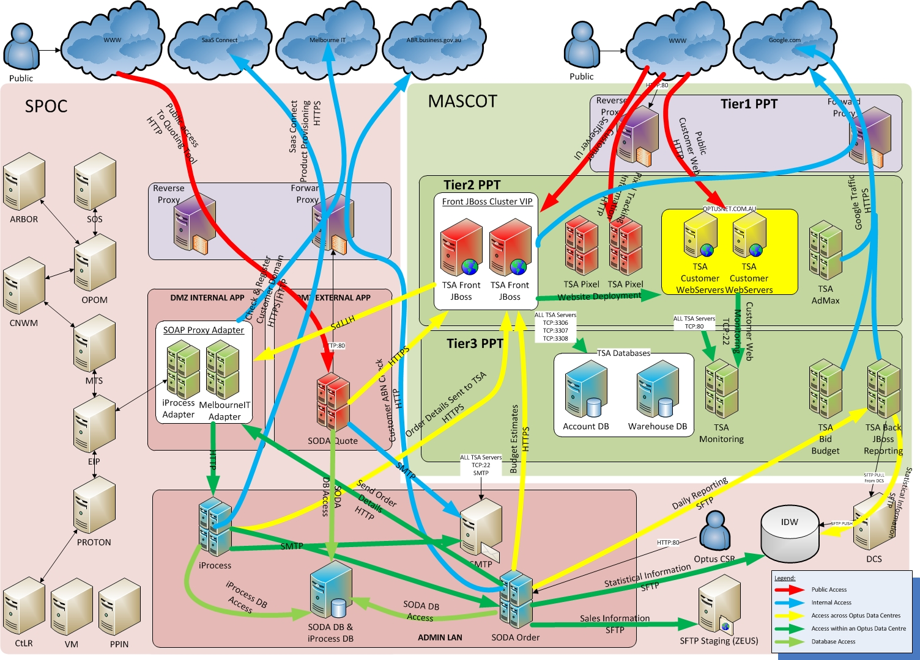
Overall Connectivity

Slide 9
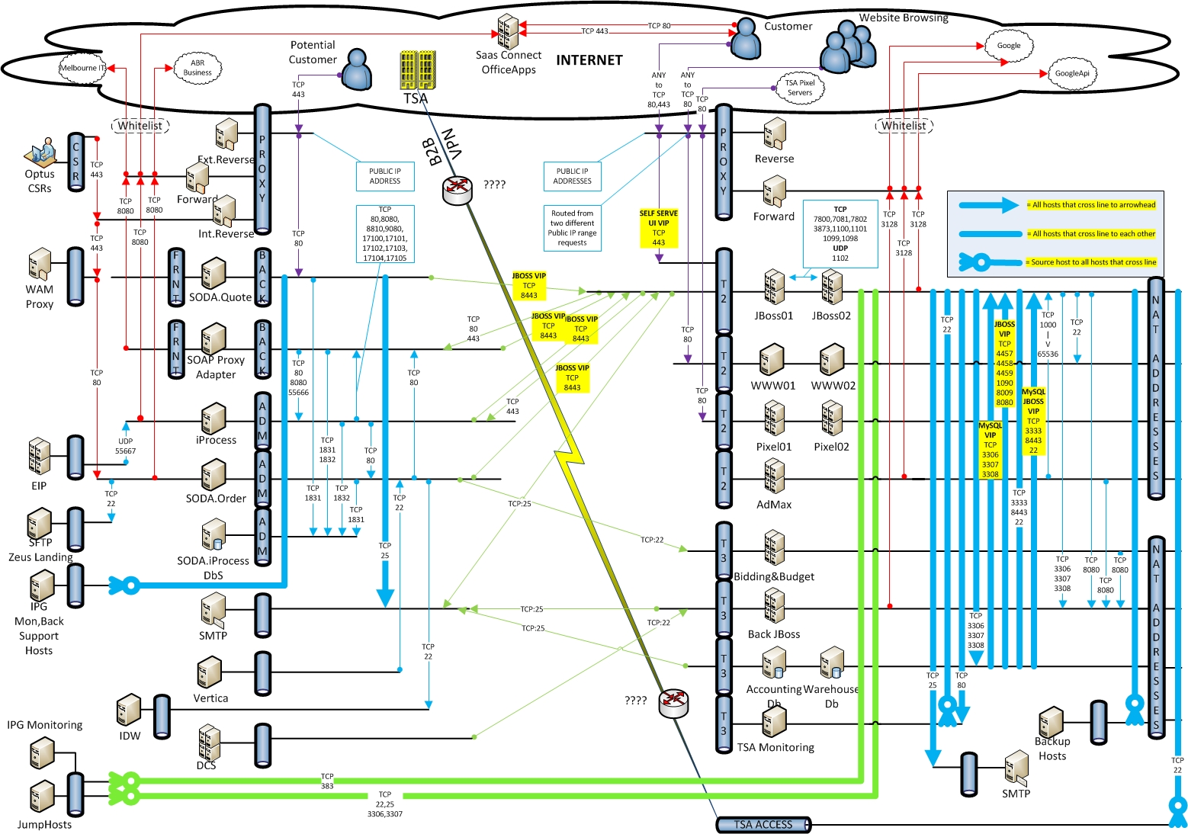
Detail Connectivity

Slide 10
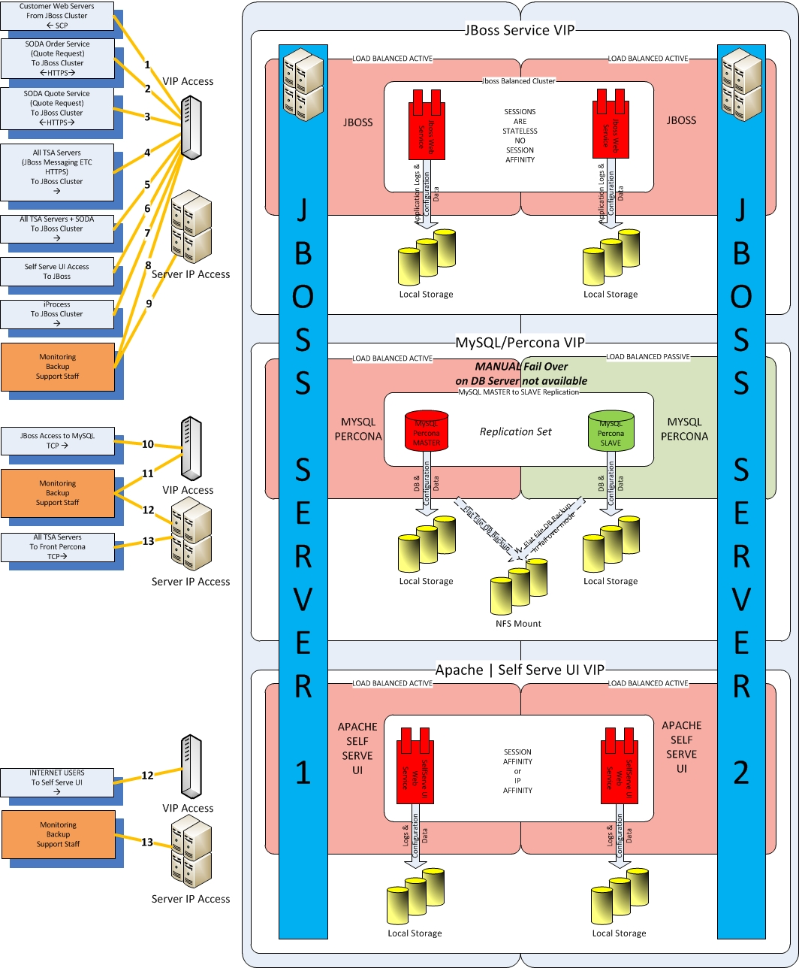
Jboss DB Stack

